Slide 1
TRADE MARKS/Copyright
Prof. Krishna Misra
Indian Institute of Information Technology, Allahabad
16-02-2021

Slide 2
Trade Marks
A Trademark generally refers to a “brand” ,”tag line” or “logo”.
Trademark registration can also be obtained for a business name, distinctive catch phrases, taglines or captions.
Properly used and promoted, a Trademark may become the most valuable asset of a business.
Trademarks such as Coca Cola, HP, Canon, Nike and Adidas serve as an indication of origin of the goods as well as an indication of quality.
It is also essential to obtain trademark registration for the business name/trade name under the Trademarks Act.

Slide 3
Catchy taglines and slogans are important for a brand

Slide 4
Examples of tag lines/slogans of some big brands
Walmart – Save Money. Live Better.
Nike – Just do it.
Levis – Quality never goes out of style.
Energizer – Keeps going and going and going.
PlayStation – Live in your world. Play in ours.
Nikon – At the heart of the image.
FedEx – The World on time.
Disneyland Resort – Where dreams come true.
McDonalds – I’m loving it.
Burger King – Have it your way.
Coca Cola – Open Happiness.
Adidas – Impossible is nothing.
IBM – Solutions fro a small planet.
Kodak – Share moments. Share life.
M&M’s – Melts in your mouth, not in your hands.
Campbell’s – Mmm mmm good!
BMW – The ultimate driving machine.

Slide 5

5 important tips for writing tag line
1.Share your commitment. What is your company devoted for it’s customers? Use your slogan to show why your brand can be trusted.
2. Keep tag line simple , catchy and short (1 0r 2 words).
3. Make it fun, and make it a jingle to make it
easily remembered. One of the most popular taglines is
from Energizer. Who could forget the bunny who
“keeps going and going and going”?
4. Highlight what makes your company different. Your slogan should state what is unusual about your brand or something that is not standard to your competitors.
5. Be honest and reflect your brand honestly and accurately. Are you really “number 1” or “the very best”? Be realistic. A good example is Visa’s tagline: “It’s everywhere you want to be”. Visa’s tagline emphasizes the company’s advantage in a clever but real way.

Slide 6
Trade Mark Act, 1999
The objective of the Trade Marks Act, 1999 is to register trade marks applied for in the country
To provide for better protection of trade mark for goods and services
To prevent fraudulent use of the mark.
The main function of the Registry is to register trade marks which qualifies for registration under the Act and Rules

Slide 7
Trade Mark Search
A trademark availability search is highly advisable before huge amounts of money and time are invested in a trademark
The guidance of an experienced trademark attorney are extremely worthwhile
Before filing a trademark application, it is necessary to identify the classes in which you wish to seek protection for your trademark.
All goods and services are divided into 45 classes.

Slide 8
Some classes of Trade Marks(TM)
Chemicals used in industry, science, photography, agriculture, horticulture and forestry
Paints, varnishes, lacquers; preservatives etc.
Bleaching preparations and other substances for laundry use
Pharmaceutical and veterinary preparations; sanitary preparations for medical purposes
Common metals and their alloys
Machines and machine tools; motors and engines
Surgical, medical, dental and veterinary apparatus and instruments
Firearms; ammunition and projectiles; explosives; fireworks.
Household or kitchen utensils and containers
Clothing, footwear, headgear.
Alcoholic drinks

Slide 9
Filing Trade Mark Application
While filing a trademark application, the class of goods and services to which the trademark pertain must be mentioned in the application.
It is important to choose the right class of trademark while filing the application as wrong classification of trademark could hamper the trademark registration process and/or diminish the legal protection for the mark under the Trademark Act.
Trademark application can be filed in more than one class, if the activity of the business involves diverse goods or services falling under different trademark classifications.
Further, even if a registered trademark exists under one class, another entity can file a trademark application for the same mark under a different class.
Hence, filing of trademark application under one class does not provide complete exclusivity over use of the mark.
Trademark only provides exclusivity for use of the mark with respect to the class of goods or services for which the trademark is registered.
Use the trademark class finder tool to find the correct trademark class for your goods or service from over 8000 goods and services.

Slide 10
Copyright Act
The Copyright Act 1957 (as amended by the Copyright Amendment Act 2012) governs the subject of copyright law in India.
The Act is applicable from 21 January 1958.
The Copyright Act 1957 was the first post-independence copyright legislation in India and the law has been amended six times since 1957.

Slide 11
Copyright
According to US constitution copyright is “To promote the progress of science and useful arts, by securing for limited times to authors and inventors the exclusive right to their respective writings and discoveries.”
The purpose of Copyright is to give the creator control and a monopoly on royalties for a period of time and it promotes creativity.

Slide 12
What is protected?
literary works (e.g., all text, including computer software);
musical works;
dramatic works;
pantomimes and choreographic works;
pictorial, graphic, and sculptural works;
motion pictures and other audiovisual works;
sound recordings;
architectural works.

Slide 13
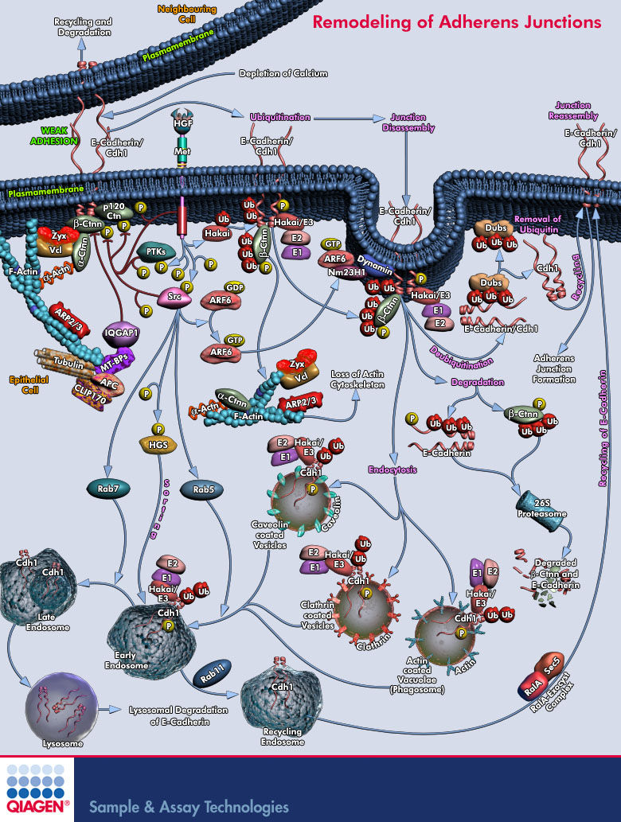
Photographs are “Pictorial Works”
Notes:
Add examples of images to enhance the program. This is just a “clip art” filler from PowerPoint

Slide 14
Facts about Copyright
Photographs, text and video are all copyrighted the moment they are created.
No action is required by the creator of photographs, text or video in order to protect their works. All creative works are protected instantly.

Slide 15
What is not protected?
ideas, concepts, or discoveries;
titles, names, short phrases, and slogans;
works that are not fixed in a tangible form of expression such as improvised speech or dance;
works consisting entirely of information that is commonly available and contains no originality;
Anything written or created by the government.
Notes:
Remind the audience that other laws may protect these categories, for example, short phrases could have trademark protection.

Slide 16
What rights does the owner control?
Rights to:
make copies of the work;
distribute copies of the work;
perform the work publicly (such as for plays, film, or music);
display the work publicly (such as for artwork, or any material used on the internet or television); and
make “derivative works” (including making modifications, adaptations or other new uses of a work, or translating the work to another media).
Notes:
These rights are exclusive to the owner and permission is needed
Copyright is like owning a bundle of sticks (like pick up sticks). You can give different users different rights. The same image can be used on a magazine cover, in an advertisement or incorporated in a documentary film, for example.

Slide 17
Limitations
the "Fair Use" doctrine allows limited copying of copyrighted works for educational and research purposes.
The copyright law provides that reproduction "for purposes such as criticism, news reporting, teaching (including multiple copies for classroom use), scholarship, or research" is not an infringement of copyright.
Notes:
This is a defense to infringement and is limited in scope. If a use qualifies as fair use is decided by the courts, which balance various factors, and is decided on a case by case basis. If you are unsure if your use is “fair use”, it is safer to ask for permission

Slide 18
What is Fair Use
class handouts of very short excerpts from a book;
quoting for purposes of reporting the news or criticizing or commenting on a particular work of art, writing, speech or scholarship.

Slide 19
What is not Fair Use
using a photograph or other image to illustrate a newsworthy story (because the subject of the story is newsworthy it does not make the image newsworthy)
Notes:
If you want an example, when a celebrity dies, the death is newsworthy, but any photograph of them is only descriptive and must be licensed.
However, if a famous artist’s dies, the news media could show a few samples of his or her most recognized artworks without permission.

Slide 20
Example of Fair Use
class studying an artist using samples to critique and analyze his/her work;
making a collage for a school project;
manipulating an image to learn Photoshop or other software.
Notes:
What you can do in a school environment to learn design is different to what you can do in a commercial environment where you make designs for profit

Slide 21
Who owns copyright
a freelance artist who created the copyrighted work;
an employer who hires employees who create copyrighted works as part of their job.
Notes:
Just because a company pays a freelance artist to create an image, does not transfer copyright ownership.

Slide 22
How to transfer rights
in writing and signed by the party transferring the rights

Slide 23
What is infringement?
use of whole or part of an image without permission;
use beyond the scope of a license;
adapting an image without permission
(art rendering, collage);
asking another photographer to recreate the image.

Slide 24
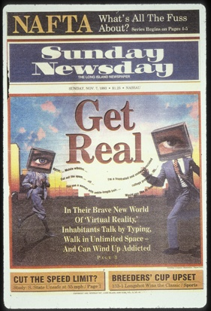
Unauthorized use
This image was created by a computer graphics artist who “borrowed” images from several sources.
Notes:
FPG v Newsday. FPG brought and action against Newsday, one of the first cases filed involving the creation of an image using computer manipulation and software. The employee combined elements from various images to create a digital work. The case was settled in an amount that included attorney’s fees.

Slide 25
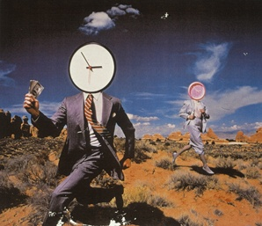
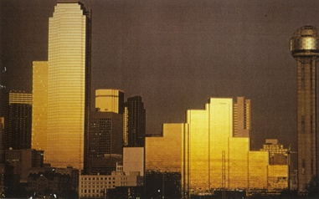
Original art
These are the two images that were infringed upon to create the Newsday cover.
Notes:
Left: photo by James Porto; Right: photo by Joseph Viesti- These images were cropped, flopped and combined but the original artist could still recognize his work as the main elements were retained

Slide 26
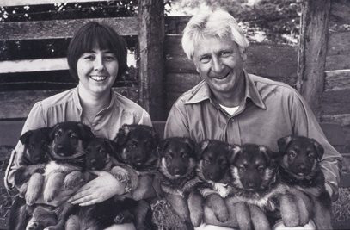
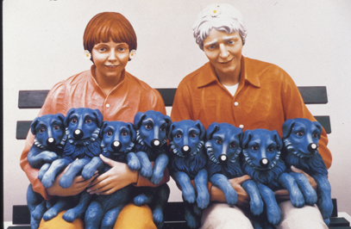
Change of medium is still an infringement
Notes:
Koons v. Art Rogers
Sculpture artist Jeff Koons lost this copyright infringement case. The artiss asserted it was fair use to change a photograph into a 3 dimensional work without obtaining a license. The court disagreed finding that substantial copyrightable elements were borrowed despite the change in medium.

Slide 27
Who is responsible?
the company that directly infringed;
employees who participated in the infringement or should have supervised;
anyone who publishes the infringed image whether they had knowledge or not.

Slide 28
How to avoid infringement
obtain a license for all the uses that will be needed;
obtain a license to create a derivative image;
obtain an art rendering or art reference license to change the medium.

Slide 29
How to license ?
Royalty Free
May use same image for many uses without additional license -restrictions still apply
No exclusive use available
Rights Managed
License limited to particular use and time period –
may request and pay for some exclusive use

Slide 30
Popular Copyright Myths
if it’s on the internet it is in the public domain and therefore free;
if there is no copyright notice, I can use the image;
if I alter the image I don’t need permission;
if I don’t profit from it, I can use it;
if I only use a part of the image I don’t need permission.
Notes:
Public Domain is very misunderstood-since 1978 copyright attaches upon creation. Cannot assume that any work on the internet is public domain
The formality of copyright notice is no longer required under US law and never required in most foreign countries, one cannot assume that any work without notice can be used.
Altering an image is an exclusive right of the copyright owner and requires permission almost all the time.
Any unauthorized use is an infringement whether you profit or not

Slide 31
Why should anyone care?
substantial monetary damages can be awarded (actual damages; profits)
statutory damages ($750-$30,000 and up to $150,000 if the infringement was willful)
the infringing use enjoined;
attorney’s fees
Notes:
Copyright Lawsuits are expensive to defend,
In addition you may ruin a client relationship if the client receives a letter from a lawyer asking it to “cease and desist” all use
Advertising campaigns are expensive, and you don’t want to be embarrassed.

Slide 32
THANK YOU

